Slide 1
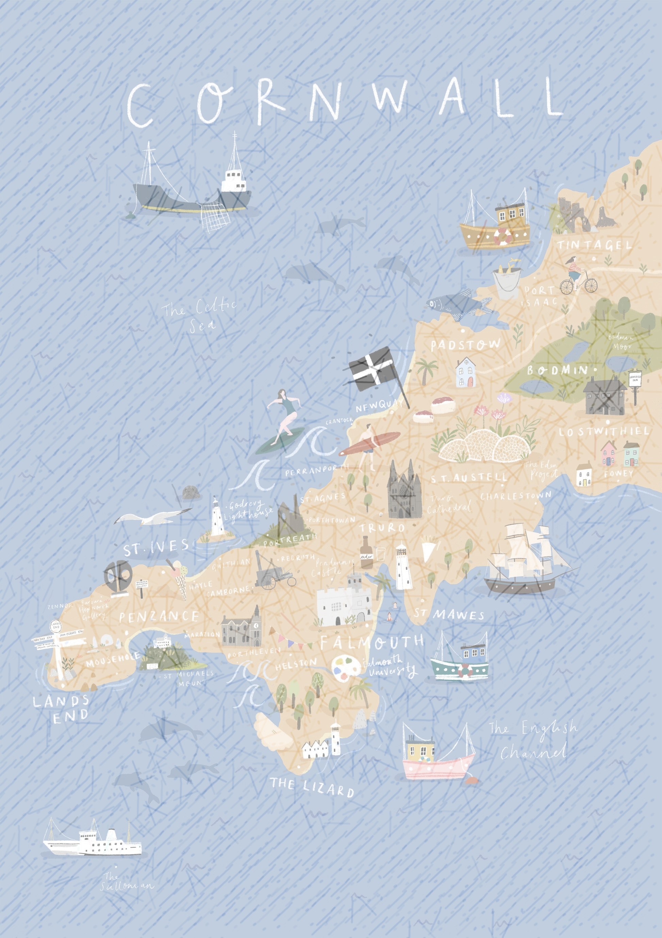









PERSONAL DEVELOPMENT Road Map - Year 3
Wish my
teacher knew
BALANCED CURRICULUM
Daily Exercise
Camp Kernow
Sports day
Harbour Lights School Event
Parliament – Introduction and MP’s voted in.
Penlee Gallery
Autumn Term
Carn Euny
Summer Production Whole School
Well Being – Zones of Regulation
Relational approach
Geevor Tin Mine visit linked to study of Rocks in Science
RNLI Assembly
RE Christmas Puppet Show – Christmas Story
Cornwall Museum
Mazey Day
ASSEMBLIES
British values
Summer Term
BLACK HISTORY MONTH - Art
Day of Reflection – Protected Characteristic
Harvest Assembly
Christmas
Nativity
After school clubs
Beach School​
Bike-ability
Forest Schools
School Parliament
Chance to Shine Cricket
Easter Craft Afternoon – Easter Bonnets
Swimming
Children in need
Walk to school week
Spring Term
Jackson Foundation Gallery trip linked to Art
PSHE
Internet Safety – Day and awareness through curriculum
Day of Reflection - Protected characteristics
World book day and National Story Telling Week activities
RE Easter Puppet Show – Easter Story

